Slide 1
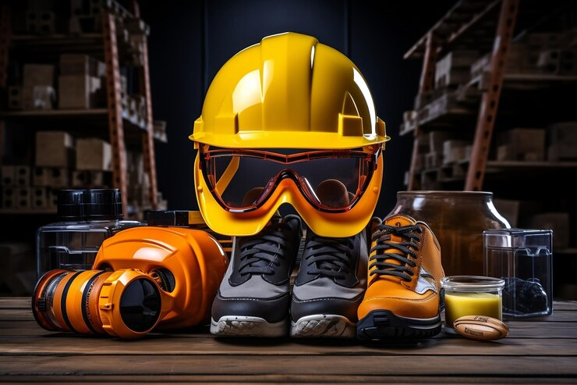

INDUSTRIAL SAFETY ENGINEERING
MODULE 2

Slide 2

SYLLABUS:
Personal protection in the work environment,
Types of PPEs, Personal protective equipment - respiratory and non-respiratory equipment.
Standards related to PPEs.
Monitoring Safety Performance: Frequency rate, severity rate, incidence rate, activity rate.
Housekeeping: Responsibility of management and employees. Advantages of good housekeeping.
5 elements of housekeeping. Work permit system- objectives, hot work and cold work permits.
Typical industrial models and methodology. Entry into confined spaces.

Slide 3

Employers have duties concerning the provision and use of personal protective equipment (PPE) at work - Article 16 - Occupational Safety and Health Convention, 1981 (No. 155)

Slide 4

PERSONAL PROTECTION IN THE WORK ENVIRONMENT
The primary approach in any safety effort is that the hazard to the workmen should be eliminated or controlled by engineering methods rather than protecting the workman through use of personal protective equipment (PPE).
Engineering methods could include design, change, substitution, ventilation, mechanical handling, automation, etc.
In situations where it is not possible to introduce any effective engineering methods for controlling hazards, the workman shall use appropriate types of PPE.
For example, in construction work there is the possibility of a hand tool, a bolt, or some loose material to fall from an elevated level and strike the head of workman below. It is therefore necessary that the construction worker wears a safety helmet.

Slide 5
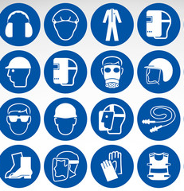
It is for such situations, both the Factories Act, 1948 and the Atomic Energy (Factories) Rules, have provisions for use of appropriate type of PPE.
Use of PPE is an important and necessary consideration in the safety development of a safety programme.
Once the safety professional decides that PPE is to be used by workmen, it becomes essential to select the right type of PPE and the management should ensure that the workman not only uses it but maintains it correctly.

Slide 6

PPE is needed when there are hazards present.
PPE has the serious limitation that it does not eliminate the hazard at the source and may result in employees being exposed to the hazard if the equipment fails.
Any item of PPE imposes a barrier between the wearer/user and the working environment.
This can create additional strains on the wearer, impair their ability to carry out their work and create significant levels of discomfort.
Any of these can discourage wearers from using PPE correctly, therefore placing them at risk of injury, ill-health or, under extreme circumstances, death.
Good ergonomic design can help to minimise these barriers and can therefore help to ensure safe and healthy working conditions through the correct use of PPE.

Slide 7

Quality of PPE
PPE must meet the following criteria with regard to its quality:
provide absolute and full protection against possible hazard; and
it should be designed and manufactured out of such material that it can withstand the hazard against which it is intended to be used.

Slide 8

CATEGORIES OF PPE
Depending upon the nature of hazard, the PPE is broadly divided into the following two categories:
Non-respiratory: those used for protection against injury from outside the body, i.e. for protecting the head, eye, face, hand, arm, foot, leg and other body parts
Respiratory: those used for protection from harm due to inhalation of contaminated air.

Slide 9
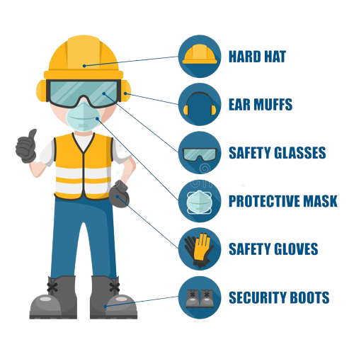
PERSONAL PROTECTIVE EQUIPMENTS
PPE is equipment that will protect the user against the risk of accidents or of adverse effects on health.
It can include items such as;
Safety helmets
Gloves
Eye protection goggles
High-visibility clothing
Safety footwear
Safety harnesses
Respiratory protective equipment (RPE).

Slide 10
Why is PPE important?
Even where engineering controls and safe systems of work have been applied, some hazards might remain.
These include injuries to:
The lungs, e.g. From breathing in contaminated air;
The head and feet, e.g. From falling materials;
The eyes, e.g. From flying particles or splashes of corrosive liquids;
The skin, e.g. From contact with corrosive materials;
The body, e.g. From extremes of heat or cold.
PPE is needed in these cases to reduce the risk.

Slide 11
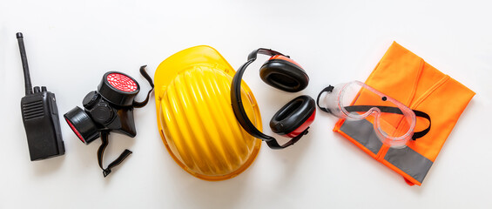
When selecting and using PPE
Choose products which are suitable to the residual risk and are the required standard, suppliers can advise you.
Choose equipment that suits the user – consider the size, fit and weight of the PPE. If the users help choose it, they will be more likely to use it.
If more than one item of PPE is worn at the same time, make sure they can be used together, e.g. wearing safety glasses may disturb the seal of a respirator, causing air leaks.
Instruct and train people how to use it, e.g. train people to remove gloves without contaminating their skin.
PPE must be properly looked after and stored when not in use, e.g. in a dry, clean cupboard. If it is reusable it must be cleaned and kept in good condition.

Slide 12


Types of PPE
There are two types of PPE
Simple personal protective equipment – this refers to equipment that has a basic design model, it protects against lower risk hazards.
Complex personal protective equipment – this refers to equipment that it more of a technical design and provides protection against fatal or serious risk.

Slide 13
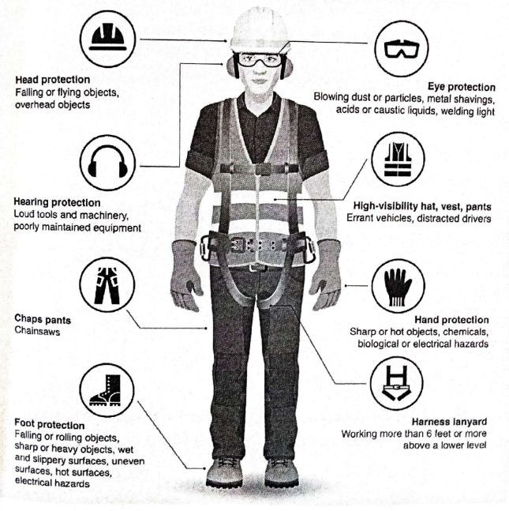

Slide 14

PPE FOR EYES PROTECTION
EYES SHOULD BE PROTECTED FROM
Glare and radiation as in the case of welding;
Flying fragments as in the case of grinding, turning on a lathe or a milling machine;
Dust as in the case of carpentry and foundry
Chemical splashes in chemical industries; Molten metal in foundries.
Eye-shields, goggles and safety spectacles are the chief means of eye protection

Slide 15
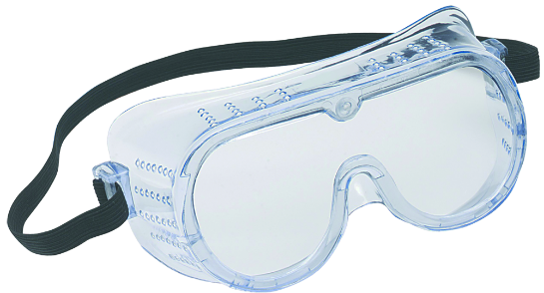
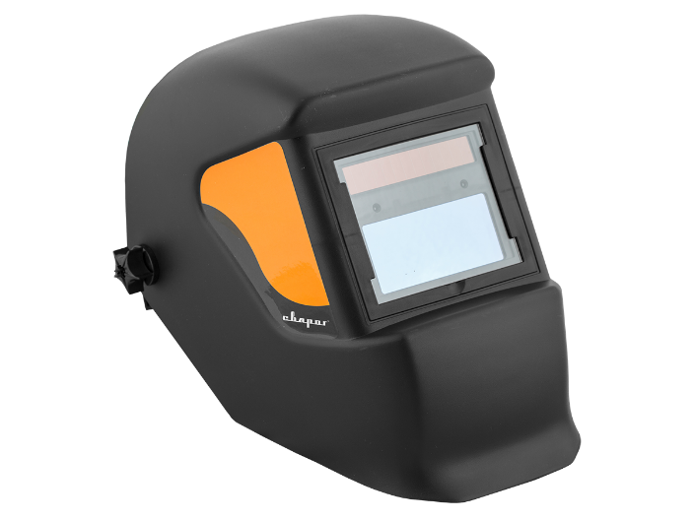
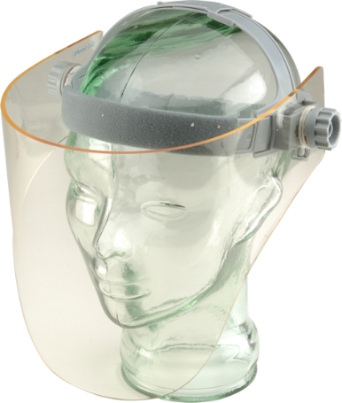

Types of PPE that can be used
Eyes
Hazards
Chemical or metal splash, dust, projectiles, gas, welding light, vapour, radiation, sparks
Options
Safety spectacles, goggles, face screens, face shields, and visors
Make sure the eye protection chosen has the right combination of impact/dust/ splash/molten metal eye protection for the task and fits the user properly.

Slide 16

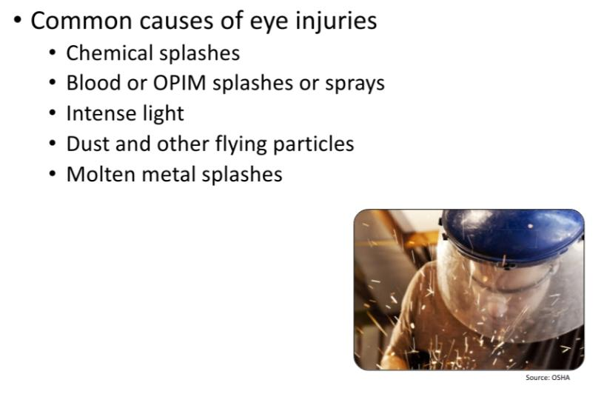
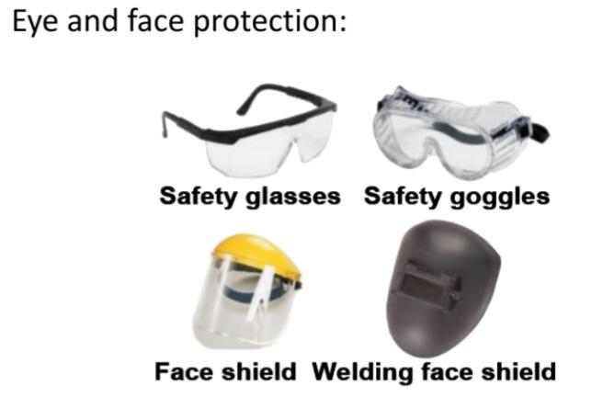
TO BE PROTECTED FROM
EYE AND FACE PROTECTION

Slide 17

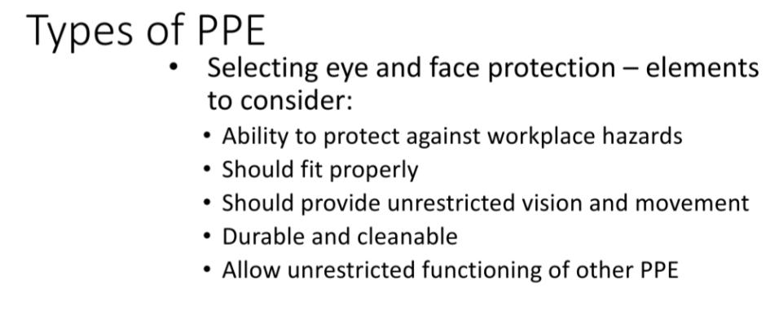

Slide 18

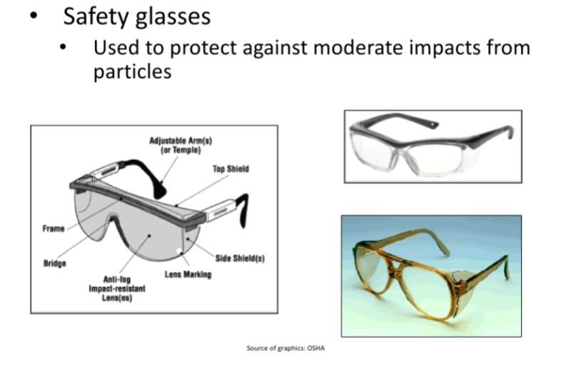

Slide 19
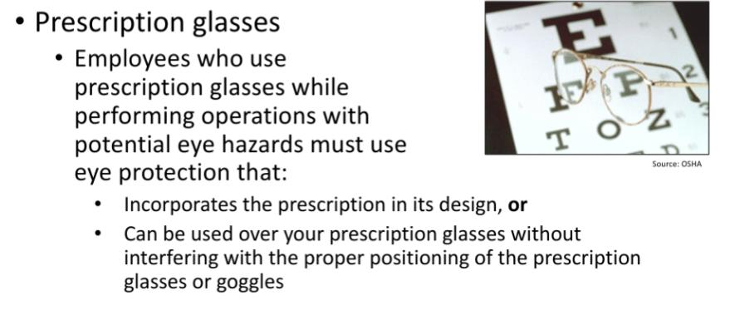

Slide 20
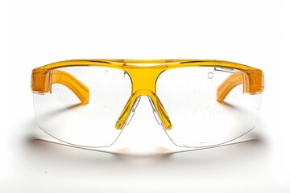
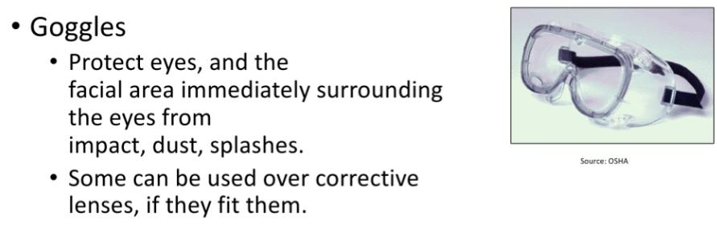

Slide 21

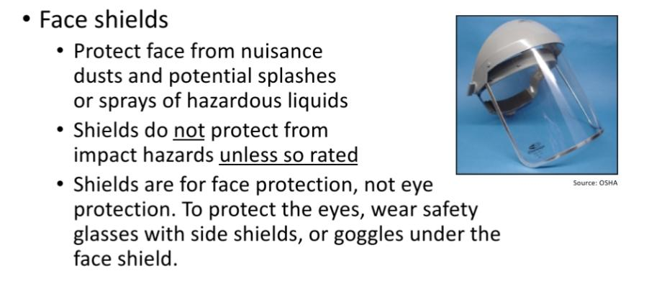
PROTECTION FOR FACE

Slide 22
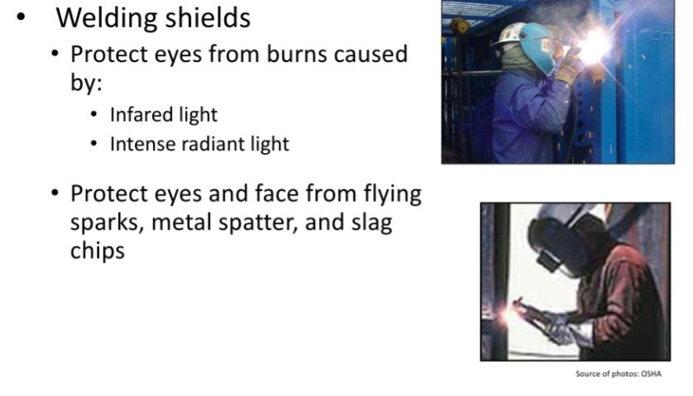

Slide 23

PPE FOR HEAD
Head is to be protected against -
Objects falling from a height particularly in construction sites;
Heat near the boilers and furnaces;
ii) Splashing of chemicals.
Various types of industrial helmets are available and they are selected and used by the employees according to the requirements.
Women worker have to use hair nets and safety caps if there is a risk of hair becoming caught in gears, drills or spinning shafts of machine.

Slide 24
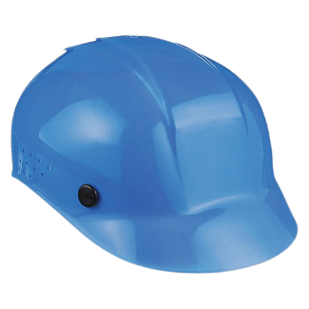
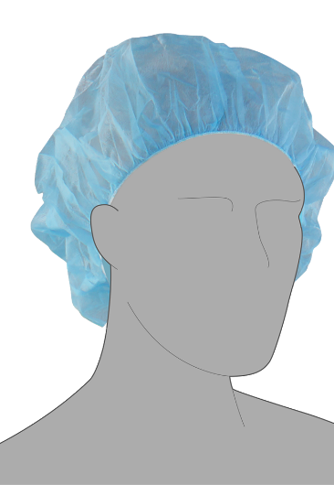

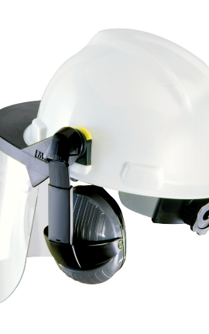
PPE FOR HEAD AND NECK
Head and neck
Hazards
Impact from falling or flying objects, risk of head bumping, hair getting tangled in machinery, chemical drips or splash, climate or temperature
Options
Industrial safety helmets, bump caps, hairnets and firefighters’ helmets
Some safety helmets incorporate or can be fitted with specially-designed eye or hearing protection.
Don’t forget neck protection, e.g. scarves for use during welding.

Slide 25
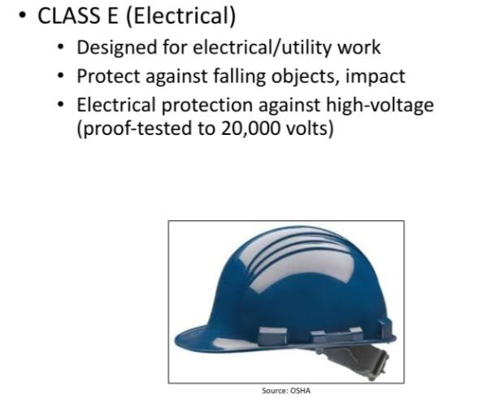
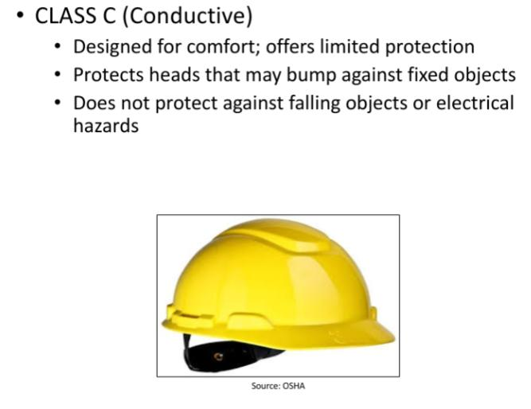

Slide 26
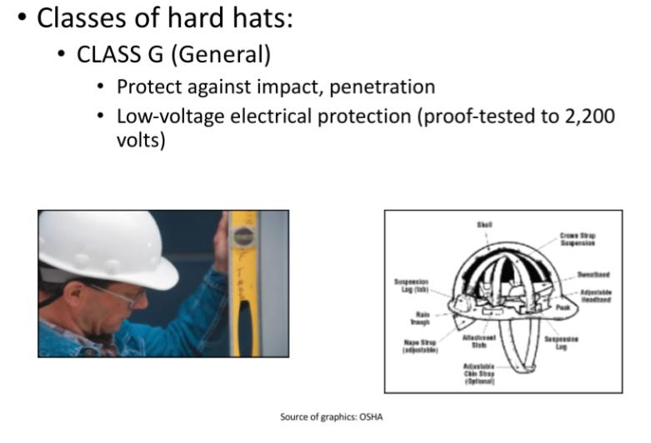

Slide 27
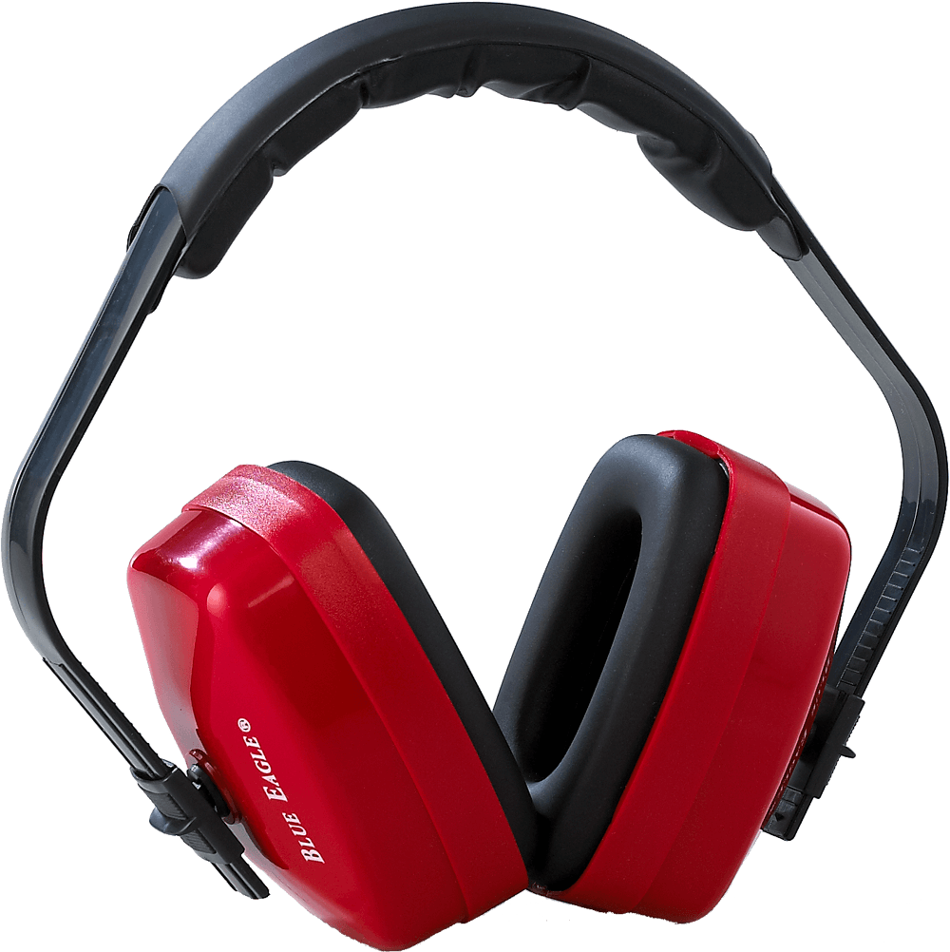
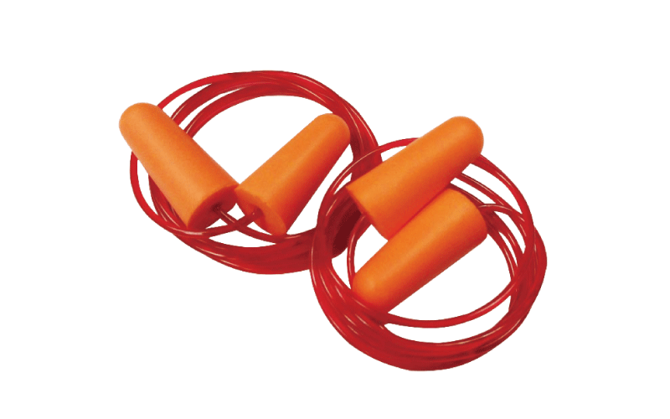
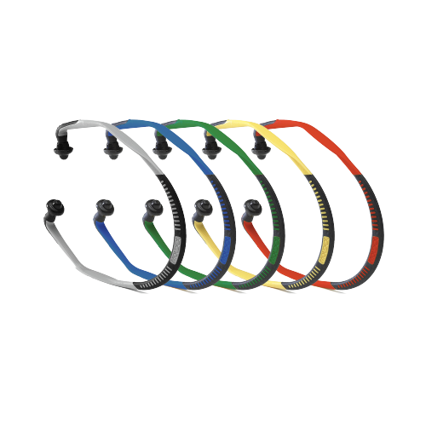

PPE FOR EARS
Ears
Hazards
Noise – a combination of sound level and duration of exposure, very high-level sounds are a hazard even with short duration
Options
Earplugs, earmuffs, semi-insert/canal caps
Provide the right hearing protectors for the type of work, and make sure workers know how to fit them.
Choose protectors that reduce noise to an acceptable level, while allowing for safety and communication.

Slide 28

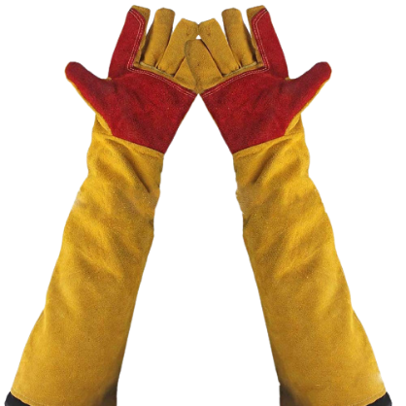


Types of PPE that can be used FOR Hands and Arms
Hazards
Abrasion, temperature extremes, cuts and punctures, impact, chemicals, electric shock, radiation, biological agents and prolonged immersion in water
Options
Gloves, gloves with a cuff, gauntlets and sleeving that covers part or all of the arm
Some materials are quickly penetrated by chemicals – take care in selection
Wearing gloves for long periods can make the skin hot and sweaty, leading to skin problems. Using separate cotton inner gloves can help prevent this

Slide 29
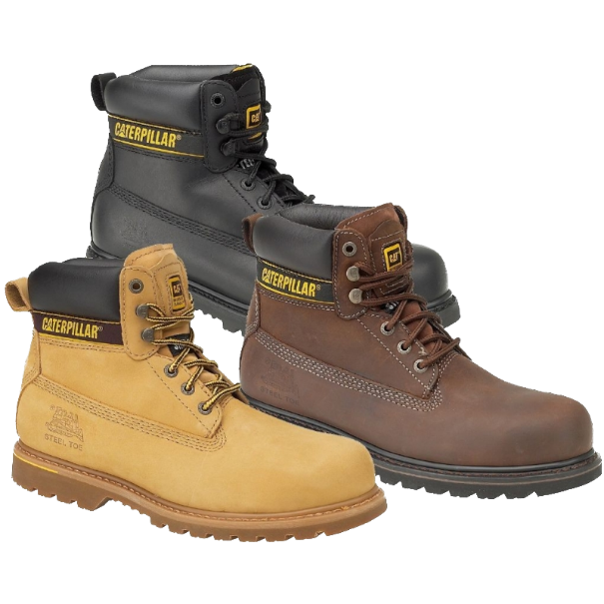
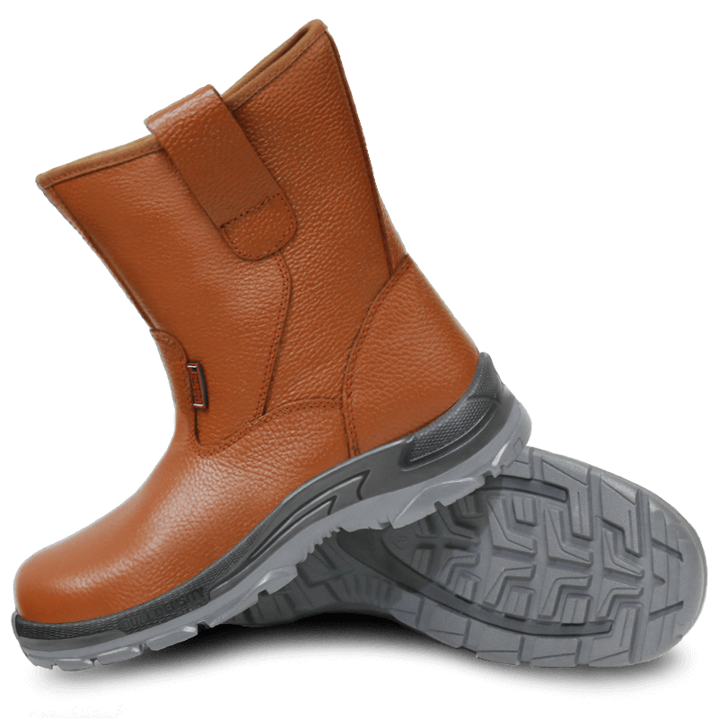
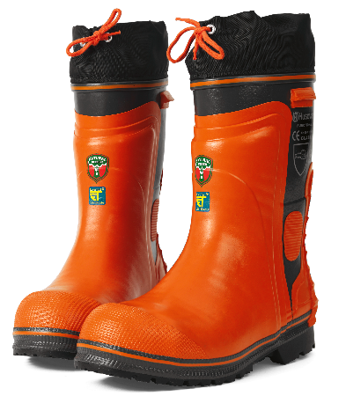
Types of PPE that can be used FOR FEET & LEGS
Hazards
Wet, hot and cold conditions, electrostatic build-up, slipping, cuts and punctures, falling objects, heavy loads, metal and chemical splash, vehicles
Options
Safety boots and shoes with protective toecaps and penetration-resistant, mid-sole wellington boots and specific footwear, e.g. foundry boots and chainsaw boots
Footwear can have a variety of sole patterns and materials to help prevent slips in different conditions, including oil- or chemical-resistant soles.
It can also be anti-static, electrically or thermally non-conductive.

Slide 30

Foot protection
In foundries, the workers must wear safety footwear which will protect their feet from injuries due to handling of molten metal. In some cases, special types of safety shoes are to be used to avoid injuries due to falling weight on toes.
Personal protective equipment should be used as a last resort. The primary thing is to eliminate the hazards so that a careless employee will not be in danger even if he does not wear a hat or an apron.

Slide 31
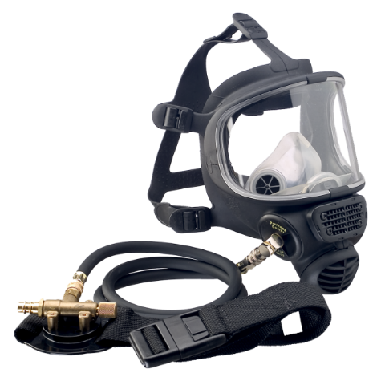
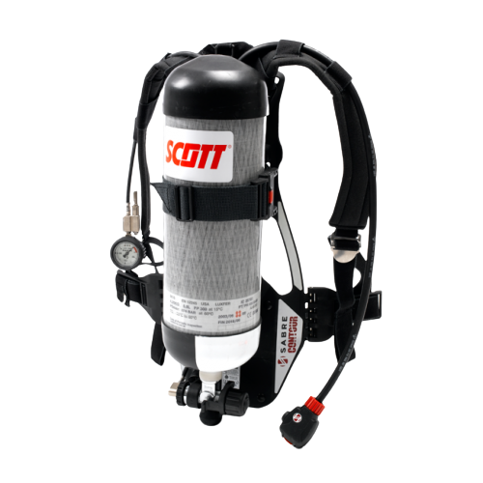
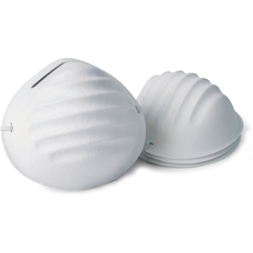
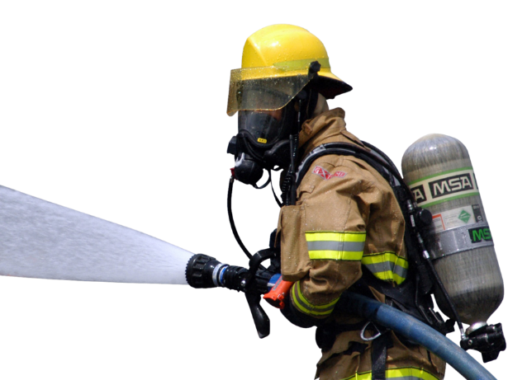
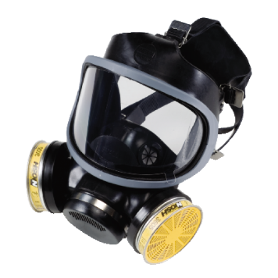
Types of PPE that can be used FOR LUNGS
Lungs
Hazards
Oxygen-deficient atmospheres, dusts, gases and vapours
Options
respiratory protective equipment (RPE)
Some respirators rely on filtering contaminants from workplace air.
These include simple filtering facepieces and respirators
Wearers must ensure the RPE fits properly, e.g. for tight-fitting respirators (filtering facepieces, half and full masks).
There are also types of breathing apparatus which give an independent supply of breathable air, e.g. fresh-air hose, compressed airline and self-contained breathing apparatus.

Slide 32
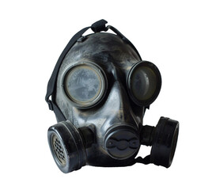
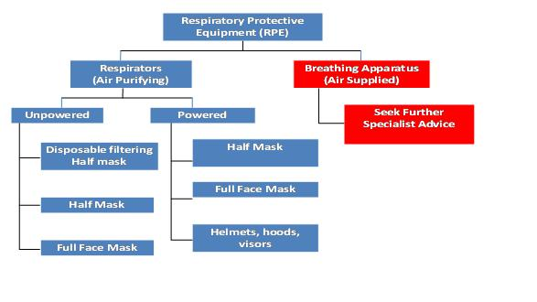
TYPES OF RPE

Slide 33

RESPIRATORY PROTECTIVE EQUIPMENT (RPE)
Respiratory Protective Equipment (RPE) is a particular type of Personal Protective Equipment (PPE), used to protect the individual wearer against the inhalation of hazardous substances in the workplace air.
RPE should only be used where adequate control of exposure cannot be achieved by other means, in other words, as a last resort within the hierarchy of control measures: Elimination, Substitution, Engineering Controls, Administrative Controls, PPE.
Employees are required to firstly attempt to eliminate hazard at source. RPE Should only be used after all other reasonably practicable control measures have been taken.

Slide 34
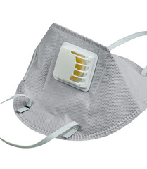
RPE is considered a last resort because it only protects individual workers, is prone to failure or misuse, such as wearing the wrong RPE for to the job, and employees wearing RPE may get a false sense of security when using RPE. Respiratory Protective Equipment (RPE) not worn or selected appropriately is totally ineffective and may give the user a false sense of protection.

Slide 35

RPE is divided into two main types: Respirator & Breathing apparatus
Respirator (filtering device) uses filters to remove contaminants in the workplace air, there are two main types
Non-powered respirators - rely on the wearer's breathing to draw air through the filter
Powered respirators - use a motor to pass air through the filter to give a supply of clean air to the wearer

Slide 36
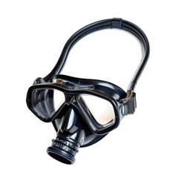
Breathing apparatus (BA) - needs a supply of breathing quality air from an independent source (eg air cylinder or air compressor)
Both respirators and BA are available in a range of difterent styles, which can be put into two main groups:
Tight-fitting facepieces (often referred to as masks) - rely on having a good seal with the wearer's face. These are available as both non-powered and powered respirators and BA. Examples are filtering facepieces, half and full face masks.
Loose-fitting facepieces rely on enough clean air being provided to the wearer to prevent contaminant leaking in (only available as powered respirators or BA). Examples are hoods helmets, visors, blouses and suits.
Only BA is suitable for use in oxygen deficient atmospheres.

Slide 37
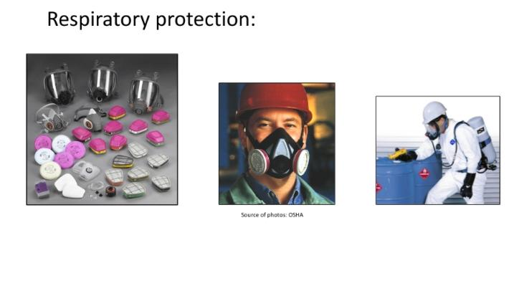
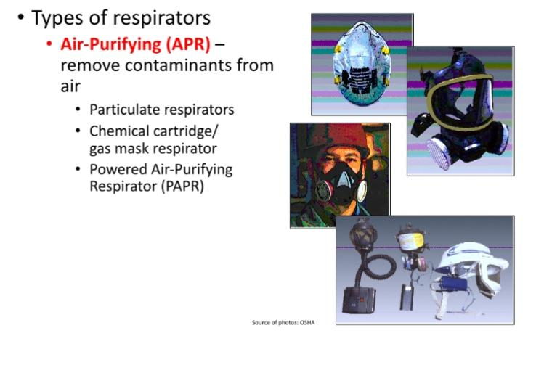
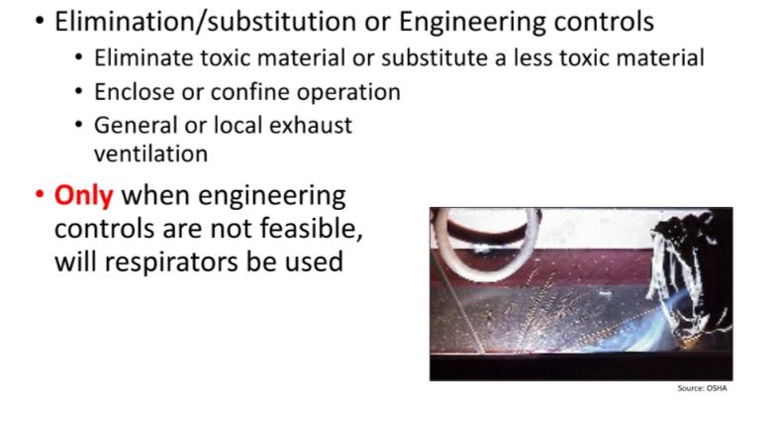
RESPIRATORY PROTECTION

Slide 38
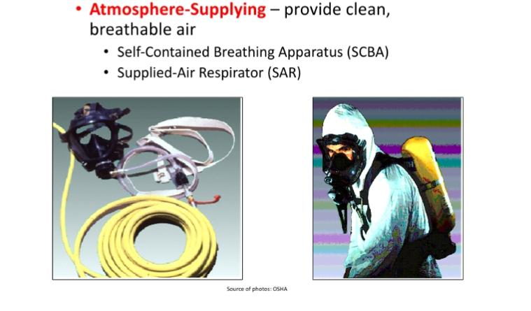

Slide 39
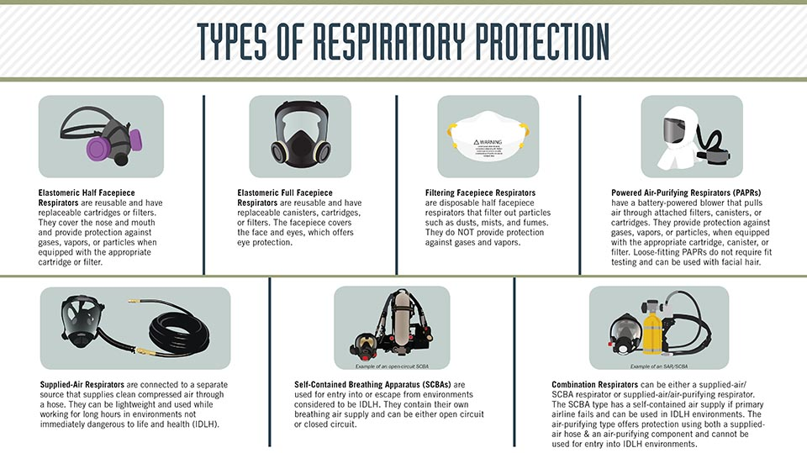

Slide 40
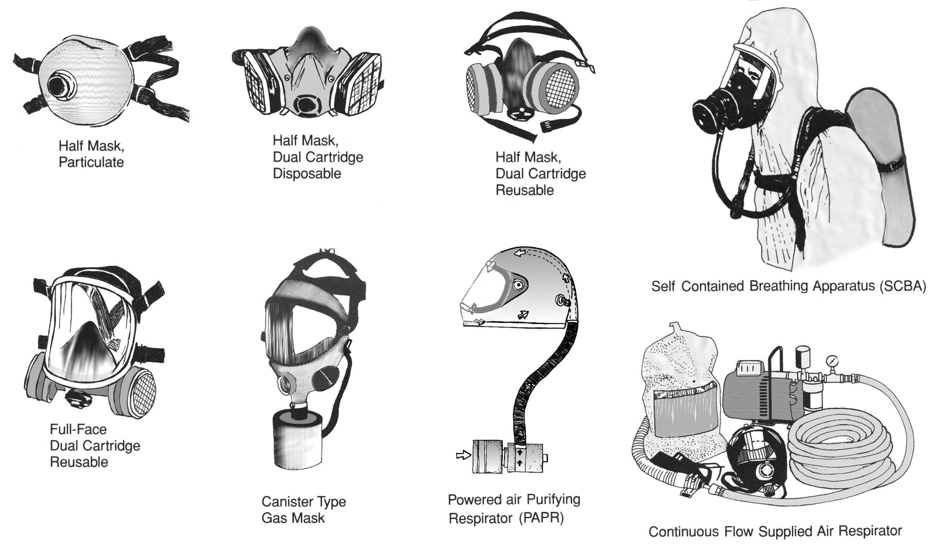

Slide 41
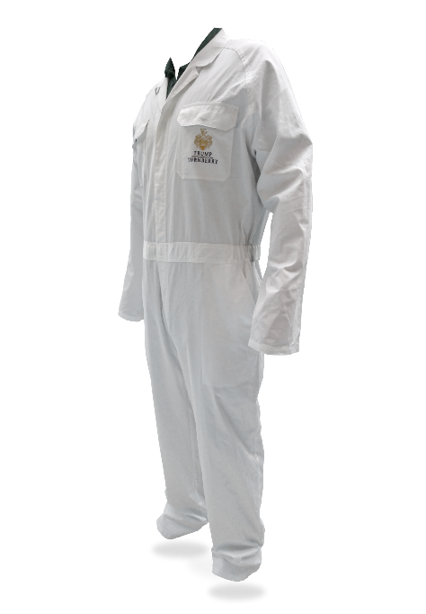
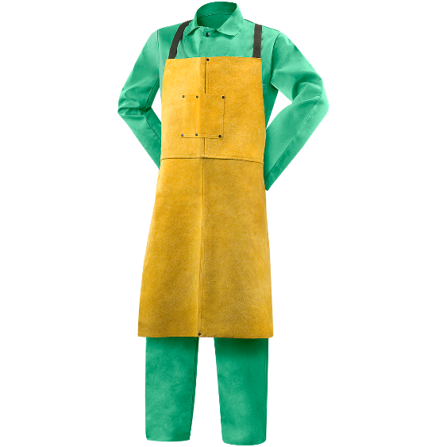
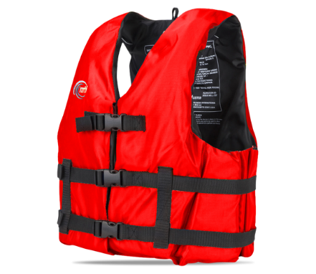
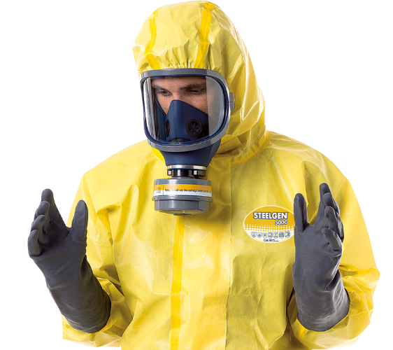
Types of PPE that can be used FOR WHOLE BODY
Whole body
Hazards
Heat, chemical or metal splash, spray from pressure leaks or spray guns, contaminated dust, impact or penetration, excessive wear or entanglement of own clothing
Options
Conventional or disposable overalls, boiler suits, aprons, chemical suits
The choice of materials includes flame-retardant, anti-static, chain mail, chemically impermeable, and high-visibility.
Don’t forget other protection, like safety harnesses or life jackets.

Slide 42

INDIAN STANDARDS FOR PPE
The Bureau of Indian Standard (BIS) has brought out many standards describing the quality of Personal
Protective Equipment used for the protection of head, eyes, face, arms, hands, legs, feet and body.
However, the testing facilities to examine the quality of Personal Protective Equipment as per the specification laid down by the BIS are available only in some manufacturing units and government laboratories with specific purpose.
Specifications for Industrial Safety Helmets (IS: 292 1984) and Specifications for Leather and Coton Gloves [IS: 690 IPart 1)-1973] are discussed here

Slide 43
Specifications for Industrial Safety Helmets (IS: 292 1984):
Material:
Shell: non-metallic.
Size
Circumference inside headband: Small: 500 540 mm.
Medium : 540-590 mm. Large: 590-640 mm.
Mass: 400 g (maximum)
Test and Performance Requirements:
Shock absorption resistance against a wooden block of 3 kg dropped from a height of 1.5 m.,
Penetration resistance against a plumb of 500 g with conical steel point falling from a height of 3 m.,
Electrical resistance against 2000 V, 50 Hz for one minute.
>5% water absorption when immersed in water for 24 hours at a temperature of 25°C.
Heat resistance in an oven at 93° t 50°C for 15 min.,
Non visible damage when a flame from a barthel Durner (IS: 4355- 1977) is applied on the shell for 10 seconds,
Sterilisation and corrosion resistance tests.
3. Essential Parts:
Shell, peak, ventilation holes.
Harness consisting of headband.
Anti-concussion tapes.
Chin strap.
4. Marking:
The following should be marked on the helmet: Trademark of manufacturer, size, ISI marking, and year of manufacture.

Slide 44
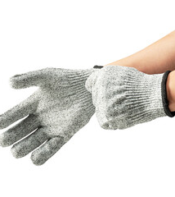
Specifications for Leather and Cotton Gloves [IS: 690 IPart 1)-1973]
It covers eleven types of industrial gloves made of leather and cotton.
Material for leather gloves: Chrome, tanned cow or young buffalo grain or split leather to conform to the following requirements:
Material for cotton drill gloves:
Cotton drill shall be unbleached 315g/m2 with a tolerance of 19 g/ sq.m.
Knitted fabrics for cuffs :2/20 all cotton.
Thread Cotton sewing thread as per IS: 1720-1969.
Size, design and stitching: As per IS: 6994 (Part 1)-1973.
Markings:
The gloves shall be legibly stamped on the inside of the cuffs with the following information:
Type and nominal size of the gloves, where applicable, the words 'light mass', 'medium mass' or 'heavy mass', manufacturer's name or recognised trademark, and year of manufacture.

Slide 45

Specifications for Leather Safety Boots and Shoes |I 1989 (Part-1 & 2)-1986]:
Should be ankle high.
Should have six eyelets (four eyelets or less in each of safety shoes.)
Toe should be reinforced with steel toe cap.
Tongue should be padded.
Bottom be made of vegetable-tanned sole leather moulded rubber sole and heel.
Eyelets be made of aluminum or brass coated steel of size 10 mm.
Mass: 1750 g/pair of size of 8 (maximum) with hobnail, toe tips and heel tips, 1650 z/pair of size 8 (rnaximum) without hob nails, toe tips and heel tips. The mass shall increase or decrease by 75g per pair for each bigger or smaller size respectively.
Steel toe cap should be as per IS 5852- 1996 and should withstand blows of 14.2 kgf.m.

Slide 46


PPE STANDARDS

Slide 47

PPE Standards
29 CFR 1910.133 Eye and Face Protection:
“The employer shall ensure that each employee uses appropriate eye or face protection when exposed to eye or face hazards from flying particles, molten metal, liquid chemicals, acids or caustic liquids, chemical gases or vapors, or potentially injurious light radiation.”

Slide 48

PPE Standards
29 CFR 1910.134 Respiratory protection:
“The employer shall provide a respirator to each employee when such equipment is necessary to protect the health of such employee.
The employer shall provide the respirators which are applicable and suitable for the purpose intended.
The employer shall be responsible for the establishment and maintenance of a respiratory protection program

Slide 49

PPE Standards
29 CFR 1910.135 Head protection
“The employer shall ensure that each affected employee wears a protective helmet when working in areas where there is a potential for injury to the head from falling objects.
The employer shall ensure that a protective helmet designed to reduce electrical shock hazard is worn by each such affected employee when near exposed electrical conductors which could contact the head.

Slide 50

PPE Standards
29 CFR 1910.136 Occupational foot protection:
“The employer shall ensure that each affected employee uses protective footwear when working in areas where there is a danger of foot injuries due to falling or rolling objects, or objects piercing the sole, and where such employee's feet are exposed to electrical hazards.”

Slide 51

PPE Standards
29 CFR 1910.137 Electrical protective equipment:
details the design requirements for specific types of electrical protective equipment—rubber insulating blankets, rubber insulating matting, rubber insulating covers, rubber insulating line hose, rubber insulating gloves, and rubber insulating sleeves used for the primary insulation of employees from energized circuit parts.

Slide 52

PPE Standards
29 CFR 1910.140 Hand protection:
“Employers shall select and require employees to use appropriate hand protection when employees' hands are exposed to hazards such as those from skin absorption of harmful substances; severe cuts or lacerations; severe abrasions; punctures; chemical burns; thermal burns; and harmful temperature extremes.”

Slide 53
PPE Standards
29 CFR 1910.132 General requirements:
says that all PPE has to meet these minimum requirements:
Provide adequate protection against the particular hazards for which they are designed
Be of safe design and construction for the work to be performed
Be reasonably comfortable when worn under the designated conditions
Fit snugly and not unduly interfere with the movements of the wearer
Be durable
Be capable of being disinfected
Be easily cleanable
Be distinctly marked to facilitate identification only of the manufacturer

Slide 54

IS Standards related to PPEs
HEAD PROTECTION
IS CODE 2745 : 1983 – Specification for non-metal helmet for firemen and civil defence personnel.
IS CODE 2925 : 1984 – Specification Industrial safety helmet.
IS CODE 4151 : 1993 – Specification for protective helmets for scooter and motorcycle riders.
BODY PROTECTION
IS CODE 3521 : 1999 – Industrial safety belt and harness.
IS CODE 4501 : 1981 – Specification for aprons.
IS CODE 6153 : 1971 – Protective leather clothing.
IS CODE 7352 : 1974 – X-ray lead protective aprons.
IS CODE 8519 : 1977 – Guide for selection industrial safety equipment for the body.
IS CODE 8990 : 1978 – Code of practice for care and maintenance of industrial safety clothing

Slide 55
IS Standards related to PPEs
EAR PROTECTION
IS CODE 6229 : 1980 – Methods for measurement of real-ear protection of hearing protectors and physical attenuation of ear muffs.
IS CODE 8520 : 1977 – Guide for selection of industrial safety equipment for eye, face and ear protection.
IS CODE 9167 : 1779 – Specification for ear protectors
EYE AND FACE PROTECTION
IS CODE 1179 : 1967 – Equipment for eye and face protection during welding.
IS CODE 5983 : 1980 – Eye Protector.
IS CODE 7524 : 1980 – Method of test for eye protectors: -non optical tests. (part -1)
IS CODE 2521 : 1977 – Industrial safety face shield with plastic visor (part – 1)
IS CODE 2521 : 1994 – Industrial safety face shield with wire mesh visor (part – 2)

Slide 56

FEET AND LEG PROTECTION
IS CODE 1989 : 1986 – Specification for leather safety boots and shoes – for miners (part – 1).
IS CODE 1989 : 1986 – Specification for leather safety boots and shoes -for heavy metal industries (part – 2)
IS CODE 3737 : 1966 – Leather safety boots for workers in heavy metal industries.
IS CODE 3738 : 1998 – Rubber boots – Specification.
IS CODE 3976 : 2003 – Protective rubber canvas boots for miners – Specification.
HANDS PROTECTION
IS CODE 2573 : 1986 – Specification for leather, gauntlets and mittens.
IS CODE 4770 : 1991 – Rubber Gloves – electrical purposes – specification.
IS CODE 6994 : 1973 – Specification for safety gloves –leather and cotton gloves (part – 1).
IS CODE 8807 : 1978 – Guide for selection of industrial safety equipment for the protection of arms and hands.

Slide 57
IS Standards related to PPEs
RESPIRATORY PROTECTION
IS CODE 8318 : 1977 – Colour identification markings for air purifying canisters and cartridges.
IS CODE 8347 : 1977 – Glossary of terms relating to respiratory protective devices.
IS CODE 8522 : 1977 – Respirators chemical cartridge.
IS CODE 8523 : 1977 – Respirators canister type gas masks.
IS CODE 9473 : 2002 – Respiratory protective devices -filtering half masks to protect against particles – specification
IS CODE 9563 : 1980 – Carbon monoxide filter self rescuers.

Slide 58

Monitoring Safety Performance:
The primary goal of a safety system is to reduce operational risks and improve the overall process safety of a plant over its entire lifecycle.
In the event of a deviation or failure of the safety system, Safety Instrumented Systems (SIS) are there to ensure that a plant is taken into a safe state, limiting the negative consequences to people, equipment and the environment.
It is important that organizations in the process industry are able to react quickly under variable conditions and have the capabilities to continuously monitor and evaluate safety system performance.
Lets discuss about a few factors which are useful for the statistical analysis of safety.

Slide 59

Evolution of safety performance indicators is the best tool for gauging safety performance.
It helps in determining the main contributor for accident & determining the cause, learning about what practice went wrong so that to prevent reocurrence of such safety accidents & adopting best practices to improve safety performance.
Safety Indices which are indicators are used as tool for safety performance measurement for assessment of relative performance of safety management system.
Quantitative measurement of safety performance gives a proper valve & clear information about the most & least unsafe work in terms of lost time injuries & man days lost between the consecutive years.
It also helps to find out the deficiency or draw back in safety management system & to suggest the safety measures area where safety improvement is necessary to raise its safety performance.

Slide 60
Definitions
Accident: - An unplanned / unintended occurrence arising out of & in the course of employment of a person resulting in injury/ damage.
Near miss:-Nothing really happened because another barrier stopped the event, near misses indicate holes in the layer of defense.
Reportable accident: - Accident which occur disablement to work for a period of 48 hr. or more.
Non-Disabling injury:-Injury requires medical treatment (First aid) only without causing disablement.
Man days lost: Charges in days of earning capacity lost due to permanent disability (total or death) or due to partial disablement as specified in IS 3786.
Man hours worked: The total number of employees hours worked by all employees working in the industrial premise. It includes managerial, supervisory, and professional, technical, clerical and other workers including contractor's labor

Slide 61

Disabling Injury ( Lost Time Injury ) - An injury causing disablement extending beyond the day of shift on which the accident occurred.
Reportable Disabling Injury ( Reportable Lost Time Injury ) - An injury causing death or disablement to an extent as prescribed by the relevant statute.

Slide 62



SAFETY PERFORMANCE INDICATORS
Frequency rate (F.R) :- Number of lost time injuries per million man hours worked.
Severity Rate (S.R): Number of man-days lost per million manhours worked.
Incidence Rate (IR) :- Number of lost time injuries per thousand persons employed.

Slide 63

Safety Activity Rate -
The safety activity rate is the overall safety promotional & awareness activity which including safety training & safety inspection conducted in a year with respect to total employees present & man hours worked in a year.
This emphasizes the cost of accident prevention activities against the cost of accident occurrences incidents.

Slide 64

What does 1000000 mean ?
No of workers in a year = 500
Daily Hour Worked = 8 hrs
No. of days worked in a week = 5 days
Total hours worked in a week = 8 x 5 = 40 hrs
Total week in a year = 50 week
So, In a year = 50 week x 40 hrs/week x 500 workers = 10 00 000 man hours

Slide 65
Man-Hours Worked
The total number of employee-hours worked by all employees in the industrial premises,
It includes managerial, supervisory, professional, technical, clerical and other workers including contractors, labors etc.
It shall be calculated from the pay roll or time clock recorded including overtime.
When this is not feasible, the same shall be estimated by multiplying the total man-days worked for the period covered by the number of hours worked per day
Total number of man-days is the sum of the number of men at work on each day of the period

Slide 66
Example 1
Using the following data calculate the frequency rate of accident in an industrial plant.
Number of workers= 500
Number of disabling injuries per year= 5.
Average number of hours worked by worker per year= 2000.

Slide 67
Frequency Rate
Total number of man hours worked = total number of days * total number of hours in one day
Workers =5
Days = 5
Hours in one day = 8
Total number of man hours worked = 5*5*8 = 200
Total number of accidents = 5
Frequency rate = 5 *10^6/200 =

Slide 68
INCIDENT RATE
1ST DAY=3
2ND DAY = 5
3RD DAY = 5
4TH DAY = 2
5TH DAY = 5
AVERAGE MANPOWER = 3+5+5+2+5/5 = 4
IF TOTAL NUMBER OF ACCCIDENTS = 2
Incident rate = 2*1000/4 = 500

Slide 69

WORKPLACE HOUSEKEEPING
Workplace housekeeping may be defined as activities undertaken to create or maintain an orderly, clean, tidy and safe working environment.
Effective housekeeping can eliminate many workplace hazards and help get work done safely and properly.
Housekeeping is not just cleanliness. It includes keeping work areas neat and orderly, maintaining halls and floors free of slip and trip hazards, and removing of waste materials (e.g, paper, cardboard) and other fire hazards from work areas.
It also requires paying attention to important details such as layout of the whole workplace, aisle marking, the adequacy of storage facilities and maintenance.
Good housekeeping is also a basic part of incident & fire protection
Effective housekeeping is an ongoing operation. It is not a one time or hit-and-miss cleanup done occasionally.
Periodic "panic" cleanups are costly and ineffective in not reducing incidents.

Slide 70

Effects of bad housekeeping:
tripping over loose objects on floors, stairs and platforms
being hit by falling objects
slipping on greasy, wet or dirty surfaces
striking against projecting poorly stacked items or misplaced material
cutting puncturing or tearing the skin of hands or other parts of the body on projecting nails, wire or steel strapping
To avoid these hazards, a workplace must "maintain" order throughout a workday. Although this effort requires a great deal of management and planning, the benefits are many.

Slide 71

Good housekeeping is essential in order to:
Make and maintain a clean, neat and orderly factory work area and its surroundings.
Make work areas look pleasant, more satisfying and motivative for a worker to work.
Minimize fatigue and discomfort to the workers.
Minimize injury and accidents.
Increase the life of plant, building and the facilities it contains.
Avoid fire and other hazards.
Permit effective natural illumination and ventilation.
Necessity of Good Housekeeping:

Slide 72

Advantages of good housekeeping
Effective housekeeping results in:
Fewer accidents.
Increased life of building, machinery, tools, etc.
Improved employee morale.
Increased production.
Better product quality.
Continuous cleaning reduces housekeeping costs because intermittent cleanup is more expensive.
Little or no time is lost in searching for tools etc.
Material handling and transportation pick up speed.
Inspection, maintenance and production control functions become easier.
Much floor space otherwise occupied by unused raw material and tools, etc. is released for production.

Slide 73

Elements Of An Effective Housekeeping Program
1. Maintenance
The maintenance of buildings and equipment may be the most important element of good housekeeping.
Maintenance involves keeping buildings, equipment and machinery in safe efficient working order and in good repair.
It include maintaining sanitary facilities and regularly painting and cleaning walls.
Broken windows, damaged doors, detective plumbing and broken floor surfaces can make a workplace look neglected; these conditions can cause incidents and affect work practices.
So it is important to replace or fix broken or damaged items as quickly as possible. A good maintenance program provides for the inspection, maintenance, upkeep and repair of tools, equipment, machines and processes.

Slide 74

2. Dust and Dirt Removal
Enclosures and exhaust ventilation systems may fail to collect dust, dirt and chips adequately.
Vacuum cleaners are suitable for removing light dust and dirt that is not otherwise hazardous.
Industrial models have special fittings for cleaning walls, ceilings, ledges, machinery and other hard-to-reach places where dust and dirt may accumulate.
Special-purpose vacuums are useful for removing hazardous products. For example, vacuum cleaners fitted with HEPA (high efficiency particulate air) filters may be used to capture fine particles of asbestos or fibreglass.
Dampening (wetting) floors or using sweeping compounds before sweeping reduces the amount of airborne dust
The dust and grime that collect in places like shelves, piping, conduits, light fixtures, reflectors, windows, cupboards and lockers may require manual cleaning.
Compressed air should not be used for removing dust, dirt or chips from equipment or work surfaces.

Slide 75

3. Employee Facilities
Employee facilities need to be adequate, clean and well maintained.
Lockers may be necessary for storing employees personal belongings.
Washroom facilities require cleaning once or more each shift. They also need to have a good supply of soap, towels plus disinfectants, if needed.
If workers are using hazardous products, employee facilities should provide special precautions as needed such as showers, washing facilities and change rooms. Some facilities may require two locker rooms with showers between. Using such double locker rooms allows workers to shower off workplace
Contaminants and reduces the chance of contaminating their “street clothes" by keeping their work clothes separated from the clothing that they wear home.
Smoking, eating or drinking in the work area should be prohibited where hazardous products are handled.
The eating should be separate from the work area and should be cleaned properly each shift.

Slide 76

4. SURFACES
Floors:
Poor floor conditions are a leading cause of incidents so cleaning up spilled oil and other liquids at once is important.
Allowing chips, shavings and dust to accumulate can also cause incidents.
Trapping chips, shavings and dust before they reach floor or cleaning them up regularly can prevent their accumulation.
Areas that cannot be cleaned continuously, such as entrance ways, should have anti-slip flooring.
Keeping floor in good order also means replacing any worn, ripped, or damaged flooring that poses a tripping hazard.

Slide 77

Walls:
Light-coloured walls reflect light while dirty or dark coloured walls absorb light.
Contrasting colours warn of physical hazards and mark obstructions such as pillars.
Paint can highlight railings, guards and other safety equipment, but should never be used as a substitute for guarding.
The program should outline the regulations and standards for colours.

Slide 78

Maintain Light Fixtures
Dirty light fixtures reduce essential light levels.
Clean light fixtures can improve lighting efficiency significantly
.
Aisles and Stairways
Aisles should be wide enough to accommodate people and vehicles comfortably and safely.
Aisle space allows for the movement of people, products and materials.
Warning signs and mirrors can improve sight-lines in blind corners.
Arranging aisles properly encourages people to use them so that they do not take shortcuts through hazardous areas.
Keeping aisles and stairways clear is important.
They should not be used for temporary "overflow" or "bottleneck" storage.
Stairways and aisles also require adequate lighting.

Slide 79

Tools and Equipment
Tool housekeeping is very important, whether in the tool room, on the rack, in the yard, or on the bench.
Tools require suitable fixtures with marked locations to provide an orderly arrangement.
Returning tools promptly after use reduces the chance of it being misplaced or lost.
Workers should regularly inspect, clean and repair all tools and take any damaged or worn tools out of service.
Spill Control
The best way cleaning and maintaining machines and the best way to control spills is to stop them before they happen.
Regularly cleaning and maintaining machines and equipment is one way.
Another is to use drip pans and guards where possible spills might occur.
When spills do occur, it is important to clean them up immediately.
Absorbent materials are useful for wiping up greasy, oily or other liquid spills.
Used absorbents must be disposed of properly other and safely.

Slide 80

Waste Disposal
The regular collection, grading and sorting of scrap contribute to good housekeeping practices. It also makes it possible to separate materials that can be recycled from those going to waste disposal facilities.
Allowing material to build up on the floor wastes time and energy since additional time is required for cleaning it up.
Placing scrap containers near where the waste is produced encourages orderly waste disposal and makes collection easier.
All waste receptacles should be clearly labelled (e.g, recyclable glass, plastic, scrap metal, etc.).

Slide 81

Storage
Good organization of stored materials is essential for overcoming material storage problems whether on a temporary or permanent basis.
There will also be fewer strain injuries if the amount of handling is reduced, especially if less manual material handling is required.
The location of the stockpiles should not interfere with work but they should still be readily available when required.
Stored materials should allow at least one metre (or about three feet) of clear space under sprinkler heads.
Stored materials should not obstruct aisles, stairs, exits, fire equipment, emergency eyewash fountains, emergency showers, or first aid stations. All storage should be clearly marked.
Flammable, combustible, toxic and other hazardous material should be stored in approved containers in designated areas that are appropriate for the different hazards that they pose.

Slide 82

5S IN INDUSTRIAL HOUSEKEEPING

Slide 83

5S CONCEPT OF HOUSEKEEPING
5S occupies a prominent place as one of the basic tools to enhance the quality of the workplace.
In fact, it forms the foundation for all improvement efforts.
It is an acronym for five Japanese words and denotes a step-by-step approach for developing a clean and well-organized workplace.
A well-designed and implemented program of 5S would instill discipline and change the attitude of employees toward work.
It is considered one of the foundation level techniques for continuous improvement.
The 5S was invented in Japan and it stands for the five Japanese words that start with the letter 'S': Seiri, Seiton, Seiso, Seiketsu,and Shitsuke.

Slide 84
What Is the Goal of 5S?
5S is a Lean method intended to implement order in the workplace.
The goal of 5S is to improve efficiency by eliminating various wastes, including the waste of motion and time spent looking for tools, materials or information.
Other benefits include improved safety and morale due to a more effective work environment.

Slide 85
What Is the 5S Process?
SORT : Seiri Purge and organize work area.
SET IN ORDER : Seiton Understand where items belong to be easily accessible when needed.
SHINE : Seiso Clean work area to be free of dirt and clutter.
STANDARDIZE : Seiketsu Document and enforce/reward successful 5S behaviors.
SUSTAIN : Shitsuke Continuously audit and improve process.

Slide 86



Slide 87


Slide 88
a) Seiri (Sort)
The first step of the 5 S processes, seiri, refers to the act of throwing away all the unwanted, unnecessary and
unrelated materials in the workplace.
The idea is to ensure that everything left in the workplace related to the work.
Even the number of necessary items in the workplace must be kept to its absolute minimum.
Because of seiri, the simplification of tasks, an effective use of space, and the careful purchase of the items follow.
The most effective method to implement Seiri is to place/ attach a red tag to all unneeded items and move them to a location outside the work area for storage until disposed off.
Sorting is an excellent way to free up valuable space and eliminate such things as obsolete stock, used and broken tools,etc. irreparable jigs and fixtures, non-renewable jobs, surplus stocks

Slide 89

Create a log maintained by the Red Tag Area Manager.
How to Use the Red Tag Method:
Place items with red tags from sorted areas into the Red Tag holding area.
Keep items highly visible.
Clearly label items.
Assign a Red Tag Manager.
Document rules for: – Placing items in Red Tag area – Removal of items – Disposition of items
Red Tagging:
A method to identify items that will eventually be removed from an area. Contains Data describing:
Red Tag No.
Name/Description of item
Reason for Tagging
Date Tagged
Current Location

Slide 90

Benefits expected from Seiri (sort):
Seiri (sorts) saves productive work.
It prevents incidents of unnecessary things.
It provides clarity as to what is in stock.
It reduces unnecessary handling, as there are less number of items to handle.
It reduces the number of lockers/cabinets for storage (as numbers of filed papers/items stored are reduced)

Slide 91
b) Seiton ( Set in order) [Straighten]
Seiton means systematic, orderly, efficient, and effective arrangement of items in use.
For effective storage, answers to the following questions are required.
What items are to be stored?
Where should the items be stored?
What quantity of the items is generally required to be stored?
Are there any special storage requirements?
How often the items are to be stored or retrieved?
Therefore , Seiton means, "to arrange correctly, following correct method of doing activities and making thorough preparation so that the activities can be performed even if they occur abruptly."
Since arranging correctly is a natural follow up activity after segregation, seiri and seiton are often used and practiced together.

Slide 92

A place for everything and everything in its place.

Slide 93
Benefits of Seiton:
Easy retrieval of materials.
Time taken to search is minimized.
Unnecessary purchase is avoided.
Categorize files, mails, papers, etc. based on specific criterion
Compartmentalize cabinets/drawers/shelves/ desks.
Determine the quantity of each item and plan storage according to pre-fixed quantity.
Plan storage to ensure easy retrievability (within pre-set target time).
Color code items for easy identification.
Keep files/binders vertically and not laid out.
Plan storage of compact disks to prevent them from getting scratched.
Install visual control for the replenishment of stocks and checking missing items.
Observe a Paper destruction day once every quarter of the year.

Slide 94

c) Seiso (Shine)
Seiso is cleaning the workplace completely so that there is no dust on the floor, machines, and equipment.
The objective of seiso is to return items, jigs/fixtures, molds, equipment, and other utilities and workplaces used during work to their original clean and polished condition by removing scrap and leftovers and wiping all surfaces to make dust/ dirt free.
The presence of dust can cause abrasions, scratches, blockages, leakages, bad connection (electrical defects), quality defects (e.g. painting on dusty surfaces), variability (e.g. wrong measurements and lack of process control)..
People generally take pride in working in clean and clutter-free area and sparkling/shining helps to create ownership of the equipment and facility.
Cleaning is not a one-time activity. Some sort of standards of cleaning needs to be developed and regular follow up is necessary to sustain this improvement.
This can be done with the help of making checklists the example is shown in below.

Slide 95
The activities necessary to implement Seiso in the organization:
Keep the machines and workplace clean through sweeping floor and surroundings, dusting to make dirt free, cobweb free wiping to make oil/grease, free polishing and painting
Clean machines/work table before the start of the daily routine. Eliminate leakage/spillage.
Brainstorm for creative ideas to make cleaning and inspection easier.
Clean even places most people don't notice. Remove scrap to avoid scratching.
Clean elements to remove dirt that cause sub-standard performance.
Clean electrical contacts to avoid bad connections ( eg: electrical contacts, pushbuttons, switches, etc.)
Dust off dirt inside the computer .
Remove oil and dust before painting to ensure a better finish.
Prepare a schedule for cleaning and assign clear-cut responsibilities.
Conduct inspection to unearth problems, identify root causes, and establish corrective action.
Carry out daily follow-up cleaning to sustain this improvement.
Clean up machine, jigs/fixtures, tools/gauges, etc. after use.
Place trash bins at strategic places and empty them at the end of the shift/day.
Clean up supply lines and coolant tanks; spray paint booth, water storage tank, material handling trolleys.
Dust off parts, components, items lying on shelves in store.

Slide 96

Benefits of Seiso:
Early identification of problems like cracks/oil leakage.
Greater confidence of customers.
Improved product quality
Pride for the employees.

Slide 97

d) Seiketsu (Standardize)
The first three steps of 5S cover the basics of clearing, organizing, and cleaning a work space; on their own, those steps will provide short-term benefits.
The fourth step simply means Standardize, or "seiketsu," which standardization. By writing down what is being done, where, and by whom, we can incorporate the new practices into normal work procedure. This paves the way for long-term change.

Slide 98

Tools for Standardizing
5S checklists : Listing the individual steps of a process makes it easy for workers to follow the process completely. It also provides a simple auditing tool to check progress later on.
Job cycle charts - identify each task to be performed in a work area, and decide on a schedule or frequency for each of those tasks. Then, assign responsibility to a particular worker (or job duty). The resulting chart can be posted visibly to resolve questions and promote accountability
Procedure labels and signs: Provide operating instructions, cleaning steps, and maintenance procedures right where that information will be needed.

Slide 99

e) Shitsuke (Sustain)
Shitsuke means self-discipline. It denotes commitment to maintain orderliness and to practice the first 4S as a way of life.
The emphasis of shitsuke is the elimination of the bad habits and constant practice of the good ones.
Once a true shitsuke is achieved, the personnel voluntarily observe cleanliness and orderliness at all times, without having to be reminded by the management.
One must train oneself to keep the 4S principles and realize that by following the 5S, ultimately the work will become easier.
Shitsuke is the most difficult 'S' to implement and achieve
Since human nature is to resist change, many organiza returns to the status quo (i.e. end up with a dirty cluttered shop) a few weeks following the implementation of 5S.

Slide 100
Methodology of Shitsuke (Sustain)
Monitor the refined methods consistently.
Maintain the defined methods for continuous improvement.
Establish norms and follow them.
Keep repeating the 1 to 4 'S'

Slide 101

Benefits of Shitsuke (Sustain)
Discipline in the system.
Waste reduction.
High morale.
Neat and cleanliness.
Easier to work.
Lesser stress at work.

Slide 102


Slide 103
Advantages of 5S System
Reduction in errors/defects due to standardized procedures.
Consistent and improved quality.
Higher productivity.
Lesser accidents.
Higher morale of employees.
Gets to work in a clean, organized, and clutter-free workplace.
Lesser time to retrieve things when required.
More useable space.
Reduction in machine downtime.

Slide 104


Slide 105
Disadvantages of using the 5S method
The major problems with 5S appear when it is not properly understood, used, or implemented.
Misunderstanding of what 5S accomplishes
Resistance to change
Not addressing problems in the workplace
Lack of management support

Slide 106



Slide 107


Slide 108

Permits to work are special authorization documentation that ensures adequate risk has been accessed for the process and a level of control has been put in place to reduce the severity, likelihood, and potential of an incident occurring
A permit to work (PTW) system is a process to keep employees safe during hazardous and nonstandard operations. It involves assessing the risks, establishing a proper safety protocol based on the risks, and proper communication throughout the entire process.
The PTW system is designed to mitigate environmental, health, sustainability, and safety risks in certain operations.

Slide 109

WORK PERMIT SYSTEM
Work Permit System or Permit-To-Work (PTW) system is a formal written system used to control and execute
certain types of jobs safely, which are identified as potentially hazardous.
It is also a means of communication between different departments, plant supervisors, operators, agencies etc.
Before starting any job in an area, it must be ensuring that it is safe to work in the environment as well as with the machinery, equipment involved. In order to ensure that no work has to start before ascertaining the safe conditions, work permit system is being followed.
The work permit specifies the conditions and procedures for safe execution of the work and allows the work to be carried out under controlled risk conditions.

Slide 110

Objectives of Work Permit System
Give written permission to carry out a task
Ensure every aspect of the work is planned
Make sure every aspect of the work is checked
Put risk assessments and method statements into action
Communicate health and safety information
Provide a procedure to ensure essential controls remain in place
Provide a procedure to return the area to a safe state on completion of the work
Give a means of communication

Slide 111

Work not requiring the permit
Routine work in established workshop and adjacent yard with boundaries.
Routine material handling work in warehouses and lay down area.
Routine office work.
Visual inspection or checking without using any tools in operation area of verbal permission from assist custodians.
Work carried out by operation employees as their daily start up and shutdown of plant.
Work carried out in designated area which has declared as work permit free by Client.
Any work approved by Client on special request by contractor.

Slide 112


Slide 113
Types of work permits:
Cold work permit (Green color) is required for any job which does not involve or use of any source of ignitions, spark, and fire.
Hot work permit (Red color) is required for any job which involves or use of source of ignition, spark, and fire.
Confined space entry authorization (Yellow color) is required to enter into the confined space.
Excavation Authorization is associated with permit for excavation job, which having validity of 1 month and can be renewed for 3 months at least 3 days before expiry.

Slide 114


Slide 115

HOTWORK PERMITS
A hot work permit is a permit that is needed in some countries, and on some job sites, in order to perform work that involves a source of ignition when flammable materials are in the vicinity or that can be considered a fire hazard.
Welding, soldering, cutting and brazing are all considered hot work, as is grinding and drilling in the presence of flammable materials

Slide 116
Before performing hot work, the worker should consider following
The fitness and readiness-to-use of all the involved equipment must be tested
Task-specific personal protective equipment/ gear should be available at the site and workers must be well- qualified on how to use, clean, and store them properly
Examine the workplace completely and eliminate any visual hazards
All combustible and flammable materials should be kept away from the workplace
All appropriate fire extinguishers and first-aid boxes should be available and easily accessible
Examine the area after completing the hot work to make sure that wall surfaces and wires have not heated up
Comply with applicable regulatory requirements and legislation in the sector/location.
Risks triggered by hot work

Slide 117

Flying sparks: This is one of the major risks associated with hot work. Sparks created during hot work can get stuck in pipes, gaps, openings, and other small cracks. This can possibly smoulder and cause a fire.
Flammable residues: There is a lot of combustible hot debris and residue leftover from hot work. This could result in a massive blaze.
Hot surfaces: During hot work, there may be many flammable goods or materials that may remain in the surface. They may come into contact with a hot surface during the activity and quickly cause a fire.
Circulation of heat when working on pipes: Hot labor can overheat a pipe. This heat could easily transfer to another flammable surface through conduction, resulting in a fire.
Explosive environment: There may be highly combustible fumes or gases in the air, that might cause a fire if exposed to hot work.

Slide 118

COLD WORK PERMITS
Cold work permits are green colored permit issued for hazardous maintenance work that does not involve the ignition hazards found in hot work.
Cold work situations are determined by conducting a risk assessment for the task and the working environment. If no flammable or explosive risks are identified, a cold work permit is sufficient for carrying out
Cold work permits are green colored permits issued for the work.

Slide 119

Some examples include:
Chemical cleaning or the use of solvents,
Handling of hazardous substances (e.g., toxic/corrosive chemicals, asbestos, etc.)
The Use of resins typically used during blade repairs, any painting activity,
Heavy lifts (refer to Crane/Lifting procedure for definition),
Erecting or dismantling scaffolds,
Any non-routine and potentially hazardous activity,
Any activity requiring specific control measures to confirm safety.

Slide 120
ENTRY INTO CONFINED SPACES
Generally speaking, a confined space is fully or partially confined space that:
Is not primarily designed or intended for continuous human occupancy.
Has limited or restricted entrance or exit or configuration that can complicate first aid, rescue or evacuation or other emergency response activities
Can represent a risk for the health and safety because of following factors:
its design, construction, location or atmosphere
the materials or substances in it
work activities being carried out in it, or the
mechanical, process and safety hazards present
Confined spaces can be below or above ground. Confined spaces can be found in almost any workplace. A confined space, despite its name, is not necessarily small.
Examples of confined spaces include silos, vats, hoppers, utility vaults, tanks, water supply towers, sewers, pipes, access shafts, truck or rail tank cars, aircraft wings, boilers, manholes, pump stations,digesters, manure pits and storage bins. Ditches, wells, and trenches may also be a confined space when access or egress is limited (but they still have "blue sky" above). Barges, shipping containers and fish holds are also considered as possible confined spaces.

Slide 121
Hazards in a Confined Space
All hazards found in a regular workspace can also be found in a confined space. However, they can be even more hazardous in a confined space than in a regular worksite.
Hazards in confined spaces can include:
Poor air quality: Insufficient amount of oxygen for the worker to breathe.
Toxic gases that could make the worker ill or cause the worker to lose consciousness.
Asphyxiants - simple asphyxiants are gases which can displace oxygen in the air (normally about 21 percent). Low oxygen levels (19.5 percent or less) can cause symptoms such as rapid breathing, rapid heart rate clumsiness, emotional upset, and fatigue. As less oxygen becomes available, nausea and vomiting collapse, convulsions, coma and death can occur. Unconsciousness or death could result within minutes following exposure to a simple asphyxiant. Asphyxiants include argon, nitrogen or carbon monoxide.

Slide 122
Chemical exposures due to skin contact or ingestion (as well as inhalation of toxic gases
Fire hazard - An explosive or flammable atmosphere due to flammable liquids and gases and combustible dusts which, if ignited, would lead to fire, or explosion or explosion.
Process related hazards- such as residual chemicals, or as well as inhalation of toxic gases, release of contents of a supply line.
Physical hazards noise, heat/cold, radiation, vibration, electrical, and inadequate lighting
Safety hazards - such as moving parts of equipment, structural hazards, engulfment, entanglement, slips, or falls.
Vehicular and pedestrian traffic.
Shifting or collapse of bulk material (engulfment).
Barrier failure that results in a flood or release of free flowing solid or liquid.
Visibility - such as smoke particles in air.
Biological hazards - viruses, bacteria from fecal matter and sludge, fungi, or moulds.

Slide 123
Entering a Confined Space
The important thing to remember is that each time a worker plans to enter any work space, the worker should determine if that work space is considered a confined space.
Before entering any confined space, a trained and experienced person should identify and evaluate all the existing and potential hazards within the confined space.
Evaluate activities both inside and outside the confined space.
Air quality testing: The air within the confined space should be tested from outside of the confined space before entry into the confined space. Care should be taken to ensure that air is tested throughout the confined space, side-to-side and top to bottom
Continuous monitoring should be considered in situation where a worker is in a space where atmospheric conditions have the potential to change (e.g., broken or leaking pipe vessels, work activities create a hazardous environment isolation of a substance is not possible).

Slide 124
A trained worker using detection equipment which has remote probes and sampling lines should do the air quality testing. Always ensure the testing equipment is properly calibrated and maintained.
The sampling should show that:
The oxygen content is within safe limits - not too little and not too much.
A hazardous atmosphere (toxic gases, flammable atmosphere) is not present.
Ventilation equipment is operating properly.
The results of the tests for these hazards are to be recorded on the Entry Permit along with the equipment or method(s) that were used in performing the tests.

Slide 125
Hazards controlled in confined spaces
The traditional hazard control methods found in regular worksites can be effective in a confined space.
These include engineering controls, administrative controls and personal protective equipment.
Engineering controls are designed to remove the hazard while administrative controls and personal protective equipment try to minimize the contact with the hazard.
However, often because of the nature of the confined space and depending on the hazard, special precautions not normally required in a regular worksite may also need to be taken.
The engineering control commonly used in confined spaces is mechanical ventilation.
The entry permit system is an example of an administrative control used in confined spaces. Personal protective equipment (such as respirators, gloves, hearing protection, etc.) is commonly used in confined spaces as well.
However, wearing of PPE sometimes may increase heat and loss of mobility. Those situations should be carefully evaluated.
When using PPE, always use as part of a PPE program and be sure to evaluate all possible hazards and risks associated with PPE use.

Slide 126
Air quality maintained
Natural ventilation (natural air currents) is usually not reliable and not sufficient to maintain the air quality.
Mechanical ventilation (e.g., blowers, fans) is usually necessary to maintain air quality.
If mechanical ventilation is provided, there should be a warning system in place to immediately notify the worker in the event of a hazard or a failure in the ventilator equipment.
Care should be taken to make sure the air being provided by the ventilation system to the confined space is 'clean throughout the entire space.
Ease of air movement throughout the confined space should be considered because of the danger of pockets of toxic gases still remaining even with the use of mechanical ventilation.
Do not substitute oxygen for fresh air. Increasing the oxygen content will significantly increase the risk of fire and explosion.
The use of mechanical ventilation should be noted on the entry permit.
Ensure air being removed from the confined space exhausted away from workers on the outside.

Slide 127
Fire and explosion prevented
Work where a flame is used or a source of ignition produced (hot work) should not normally be performed in a confined space unless:
All flammable gases, liquids and vapors are removed before the start of any hot work.
Mechanical ventilator is usually used to
Keep the concentration of flammable hazardous substance less than 10% of it’s Lower Explosive Limit
Make sure that the oxygen content in the confined space is not enriched. Oxygen content should be less than 23% but maintained at levels greater than 19.5%. (These numbers can vary slightly from jurisdiction to jurisdiction.)
Surfaces coated with combustible material should be cleaned or shielded to prevent ignition.
Do not bring fuel or fuel containers into the confined space (e.g., gasoline, propane), if possible.
Ensure welding equipment is in good condition.
Where appropriate, use spark-resistant tools, and make sure all equipment is grounded properly.
While doing the hot work, the concentrations of oxygen and combustible materials must be monitored to make sure that the oxygen levels remain in the proper range and the levels of the flammable products combustible materials do not get higher than 10% of the Lower Explosive Limit.
In special cases it may not be possible, and additional precautions must be taken to ensure the safety of the worker prior to entering the confined space.

Slide 128
Other safety precautions
Many other situations or hazards may be present in a confined space. Be sure that all hazards are controlled, for example:
Any liquids or free-flowing solids should be removed from the confined space to eliminate the risk of drowning or suffocation.
All pipes should be physically disconnected or isolation blanks bolted in place. Closing valves is not sufficient.
Use two blocking valves, with an open vent or bleed valve between the blocking valves when isolating pipelines or similar conveyances to prevent entry of materials and hazardous contaminants.
A barrier is present to prevent any liquids or free-flowing solids from entering the confined space.
The opening for entry into and exit from the confined space must be large enough to allow the passage of a person using protective equipment.

Slide 129
Confined Spaces Permit
The confined space entry certificates(unless detailed on a hot work or cold work permit) are used to specify the precautions to be taken to eliminate exposure to dangerous fumes or to an oxygen-depleted atmosphere before the person is permitted to enter the confined space.
The certificate should confirm that the space is free from dangerous fumes or asphyxiating gases.
It should also recognize the possibility of fumes desorbing from residues, oxygen depletion of the atmosphere as a result of the oxidation, or the ingress of airborne contaminants from the adjacent sources.
The certificate should specify the precautions to be taken to protect the enclosed atmosphere against these hazards,
e.g forced ventilation, physical isolation or the provision of personal protective equipment including the breathing apparatus.

